Slide 1
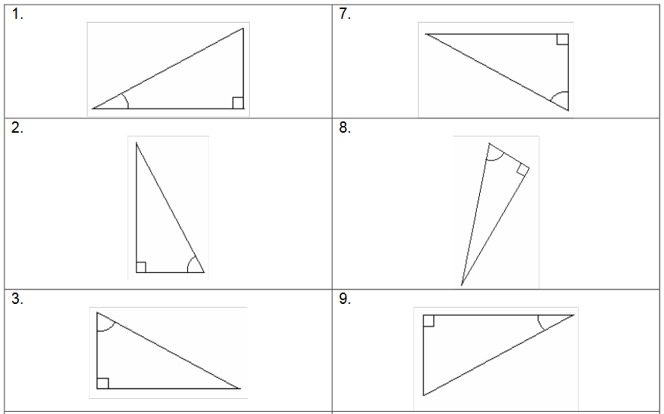
Name the sides, Opposite, Adjacent, Hypotenuse

Slide 2
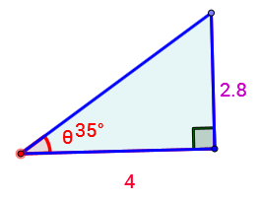
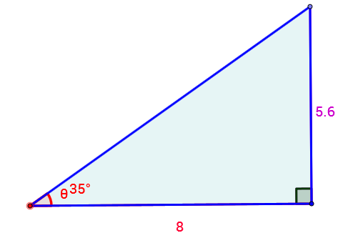
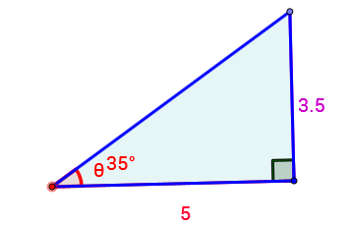
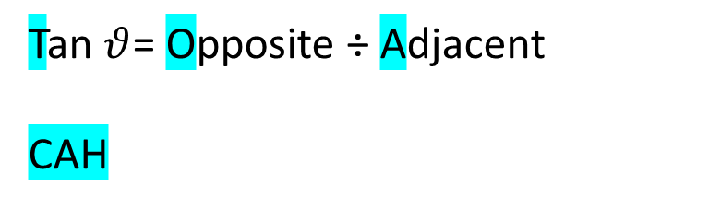
Opposite | Adjacent | O ÷ A =
Tan $θ$= Opposite ÷ Adjacent
CAH

Slide 3
Some of the uses that Trigonometry is used for …
Navigation
Architecture
Surveying
Construction
Engineering
Astronomy
Physics

Slide 4
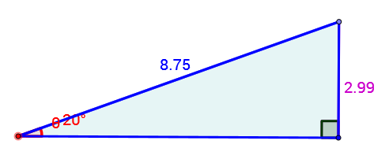
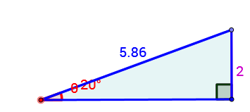
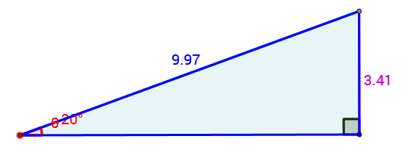
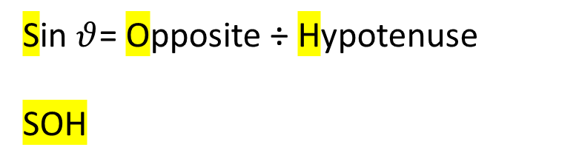
Opposite | Hypotenuse | O ÷ H =
Sin $θ$= Opposite ÷ Hypotenuse
SOH

Slide 5
Sine (sin)
We use Sine when we have the Opposite and Hypotenuse lengths.
14.1cm (1dp)
10cm
The rule we use is:
50˚
Opposite
Hypotenuse
Sinϴ=

Slide 6
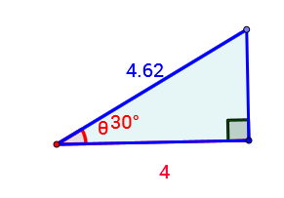
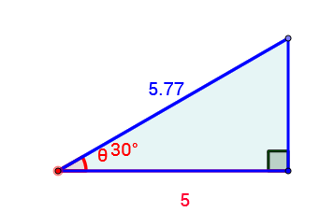
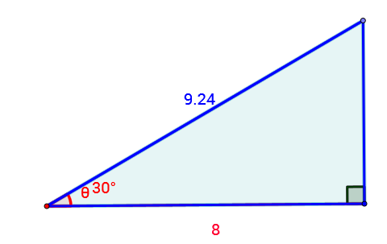
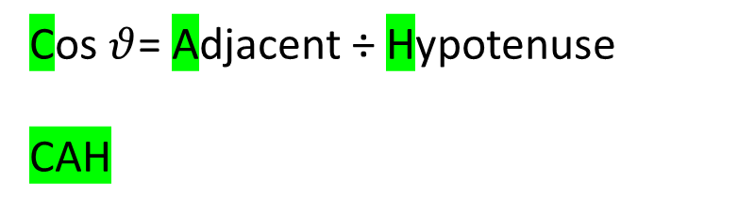
Adjacent | Hypotenuse | A ÷ H =
Cos $θ$= Adjacent ÷ Hypotenuse
CAH

Slide 7
Cosine (cos)
We use Sine when we have the Adjacent and Hypotenuse lengths.
14.1cm
The rule we use is:
50˚
Adjacent
Hypotenuse
Cosϴ=
6.1 cm (1dp)

Slide 8
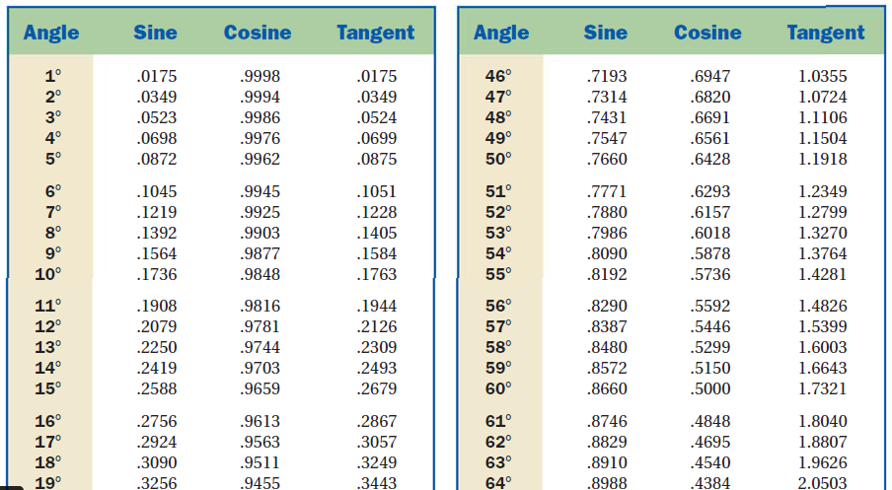
The ratios are programmed into your calculators. Each angle has it’s own unique value for each of the ratios

Slide 9
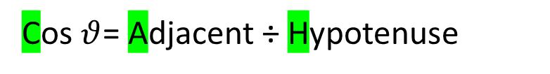
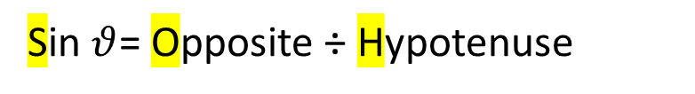

Topic : Finding sides.
24
7
30
Date
EQ : How do we Trigonometry to find the lengths of sides?
We can use SOH CAH TOA to help find the lengths of unknown sides.
SOH stands for
CAH stands for
TOA stands for
Sin $θ$= Opposite ÷ Hypotenuse
Cos $θ$= Adjacent ÷ Hypotenuse
Tan $θ$= Opposite ÷ Adjacent

Slide 10
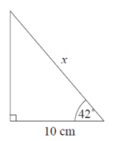

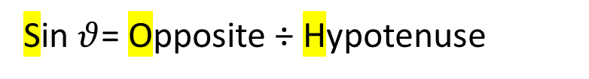
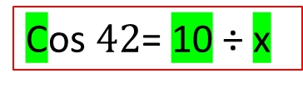

Topic : Finding sides.
24
7
30
Date
EQ : How do we Trigonometry to find the lengths of sides?
SOH stands for
CAH stands for
TOA stands for
Sin $θ$= Opposite ÷ Hypotenuse
Cos $θ$= Adjacent ÷ Hypotenuse
Tan $θ$= Opposite ÷ Adjacent
Step 1. Find the important angle.
Hyp
Step 2. Label the sides.
Opp
Step 3. Which ratio has the sides involved
Step 4. Place the information into the formula
Adj
Cos $42$= 10 ÷ x

Slide 11
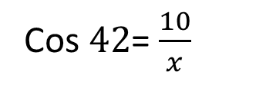
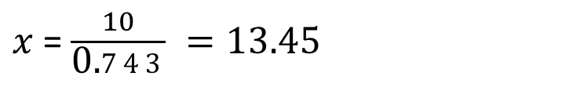
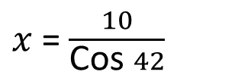
Topic : Finding sides.
24
7
30
Date
EQ : How do we Trigonometry to find the lengths of sides?
Step 1. Find the important angle.
Hyp
Step 2. Label the sides.
Opp
Step 3. Which ratio has the sides involved
Step 4. Place the information into the formula
Cos $42$= $\frac{10}{x}$
Adj
Step 5. Reorganise the equation to isolate the unknown
$x$ = $\frac{10}{\text{Cos} 42}$
Step 5. solve
$x$ = $\frac{10}{\text{0.}743} =13.45$

Slide 12
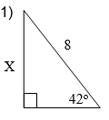
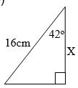
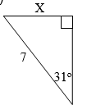
Using SOH CAH TOA to help answer Trigonometry. Lets try a few..

Slide 13
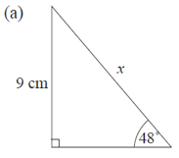
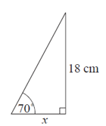
Using SOH CAH TOA to help answer Trigonometry. Lets try a few..

Slide 14
Now complete the worksheet

